Slide 1


Here's your outline to get started
Key facts about your topic
The effects of a nuclear explosion on its immediate vicinity are typically much more destructive and multifaceted than those caused by conventional explosives. Depending on the design of the weapon and the location in which it is detonated, the energy distributed to any one of these categories may be significantly higher or lower. The blast effect is created by the coupling of immense amounts of energy, spanning the electromagnetic spectrum, with the surroundings. The environment of the explosion determines how much energy is distributed to the blast and how much to radiation. In general, surrounding a bomb with denser media, such as water, absorbs more energy and creates more powerful shockwaves while at the same time limiting the area of its effect. When a nuclear weapon is surrounded only by air, lethal blast and thermal effects proportionally scale much more rapidly than lethal radiation effects as explosive yield increases. The physical-damage mechanisms of a nuclear weapon are identical to those of conventional explosives, but the energy produced by a nuclear explosion is usually millions of times more powerful per unit mass and temperatures may briefly re...
See more: Open the Notes below for more information.
Notes:
QuickStarter has created an outline to help you get started on your presentation. Some slides include information here in the notes to provide additional topics for you to research.
Summary:
The effects of a nuclear explosion on its immediate vicinity are typically much more destructive and multifaceted than those caused by conventional explosives. Depending on the design of the weapon and the location in which it is detonated, the energy distributed to any one of these categories may be significantly higher or lower. The blast effect is created by the coupling of immense amounts of energy, spanning the electromagnetic spectrum, with the surroundings. The environment of the explosion determines how much energy is distributed to the blast and how much to radiation. In general, surrounding a bomb with denser media, such as water, absorbs more energy and creates more powerful shockwaves while at the same time limiting the area of its effect. When a nuclear weapon is surrounded only by air, lethal blast and thermal effects proportionally scale much more rapidly than lethal radiation effects as explosive yield increases. The physical-damage mechanisms of a nuclear weapon are identical to those of conventional explosives, but the energy produced by a nuclear explosion is usually millions of times more powerful per unit mass and temperatures may briefly reach the tens of millions of degrees.

Slide 2
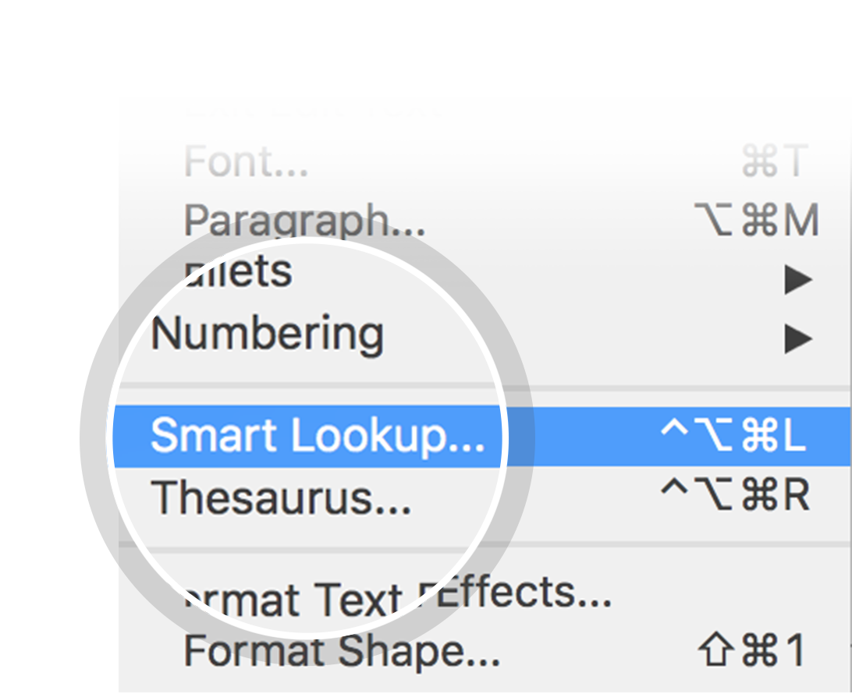
Related topics to research
Nuclear Weapon
Effects of nuclear explosions on human health
Nuclear explosion
Nuclear fallout
Nuclear Warfare
Mushroom Cloud
Neutron Bomb
Nuclear weapon design
Nuclear Electromagnetic Pulse
Nuclear weapons testing
Use Smart Lookup to learn more
1
Highlight one of the related topics
Right-click on the topic
Choose "Smart Lookup"
2
3

Slide 3
Effects of COVID in New Zealand
By
Track Stars
(Zahid Khan, Perry li,
Jiani Wu, Kaishun Yang)
Notes:
Hello everyone, We are team TRACK STARS, and we decided to analyse the Effects of Covid in New Zealand.

Slide 4
Topics and Contents Covered
Total number of COVID Cases
Vaccines Administered
Crime Rate
Deathrate
Agriculture
GDP (Gross domestic product)
Notes:
As we all know that COVID has had a huge impact on almost every sector of our economy as well as our lives.
We do not have enough time or resources to cover each sector, so we choose 4 topics, which are :
Effects of COVID on CRIME RATE
Effects of Vaccination
Effects of COVID in Agriculture sector
And
Effects of COVID on NZ GDP

Slide 5


Data Sources
Covid Data
Ministry of Health NZ (Git Repo)
https://github.com/minhealthnz/nz-covid-data
Vaccination Data
Ministry of Health NZ (Git Repo)
https://github.com/minhealthnz/nz-covid-data
Crime Rate
New Zealand Police statistics
https://www.police.govt.nz/about-us/publications-statistics/data-and-statistics?nondesktop
Death Rate
Ministry of Health NZ (Git Repo)
https://github.com/minhealthnz/nz-covid-data
Notes:
The data collected for Covid Cases and Vaccination is from Ministry of health Git-Repository.
Crime Rate statistics were collected from the NZ police website Which was another challenge.

Slide 6

Data Sources
Agriculture
Before Covid:
https://www.stats.govt.nz/information-releases/agricultural-production-statistics-june-2019-final/?fbclid=IwAR2WAR9QR33HcLXF7Nt-JAZZRukfgQiDJhFAukYjOz_HKqKOeQ8kJzxky3c
After Covid:
https://www.stats.govt.nz/information-releases/agricultural-production-statistics-year-to-june-2021-final/?fbclid=IwAR04a29AGmveWZyfI0V9i9yD-5OP68RAazrGrpmOWMw4GRZKpane8jcWjzA
GDP
https://www.stats.govt.nz/information-releases/gross-domestic-product-june-2022-quarter/?fbclid=IwAR1bfYeCwfOSBIp97SkhGlWFzReIxGYD5Q7Fl5jaCmCf3yLqgXgGKbgwjIw
Notes:
For Agriculture and GDP sector the data was collected from Stats NZ

Slide 7
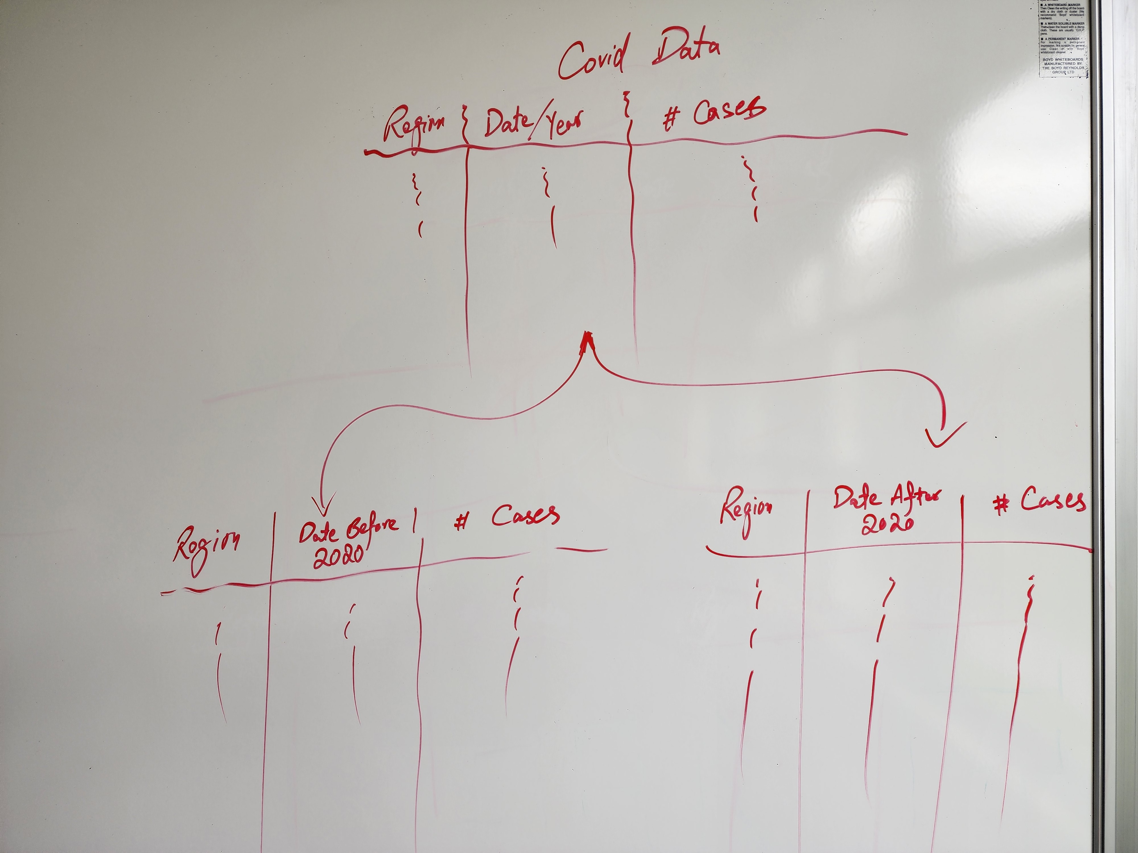
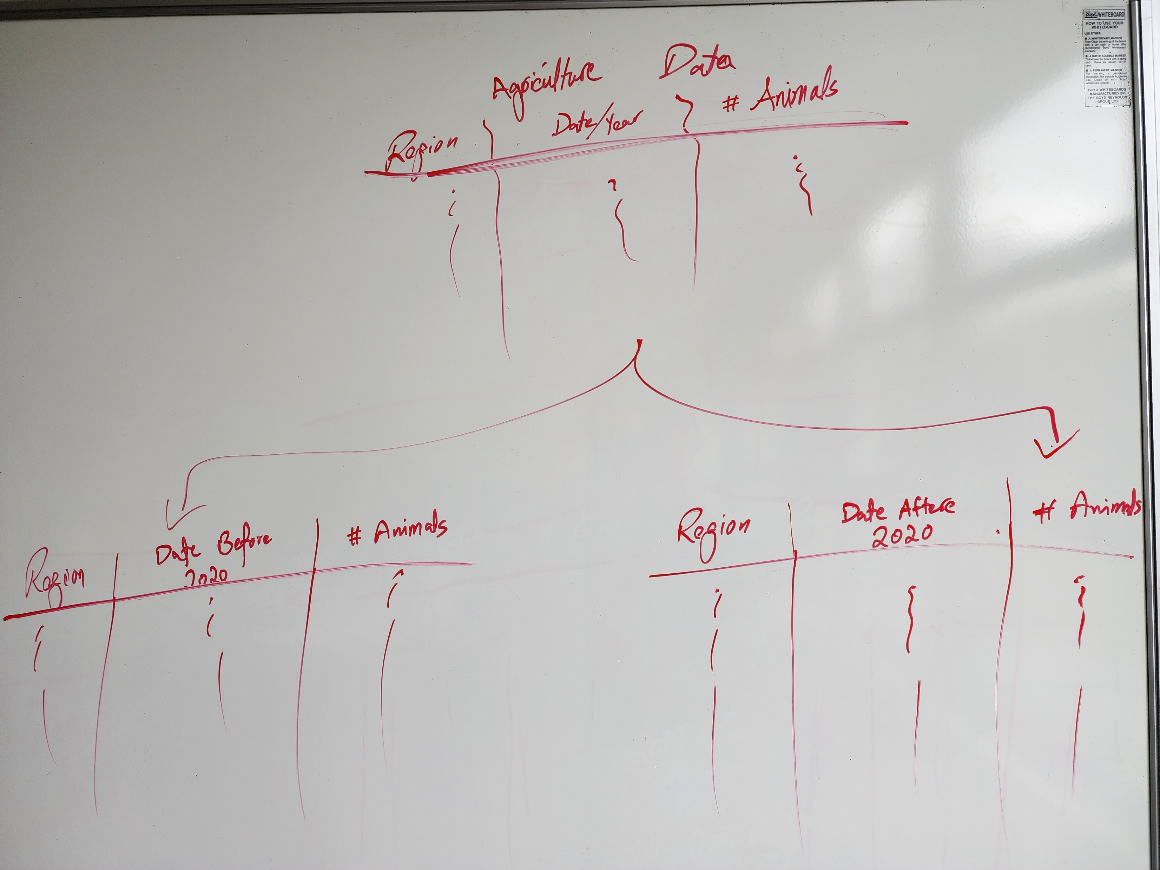
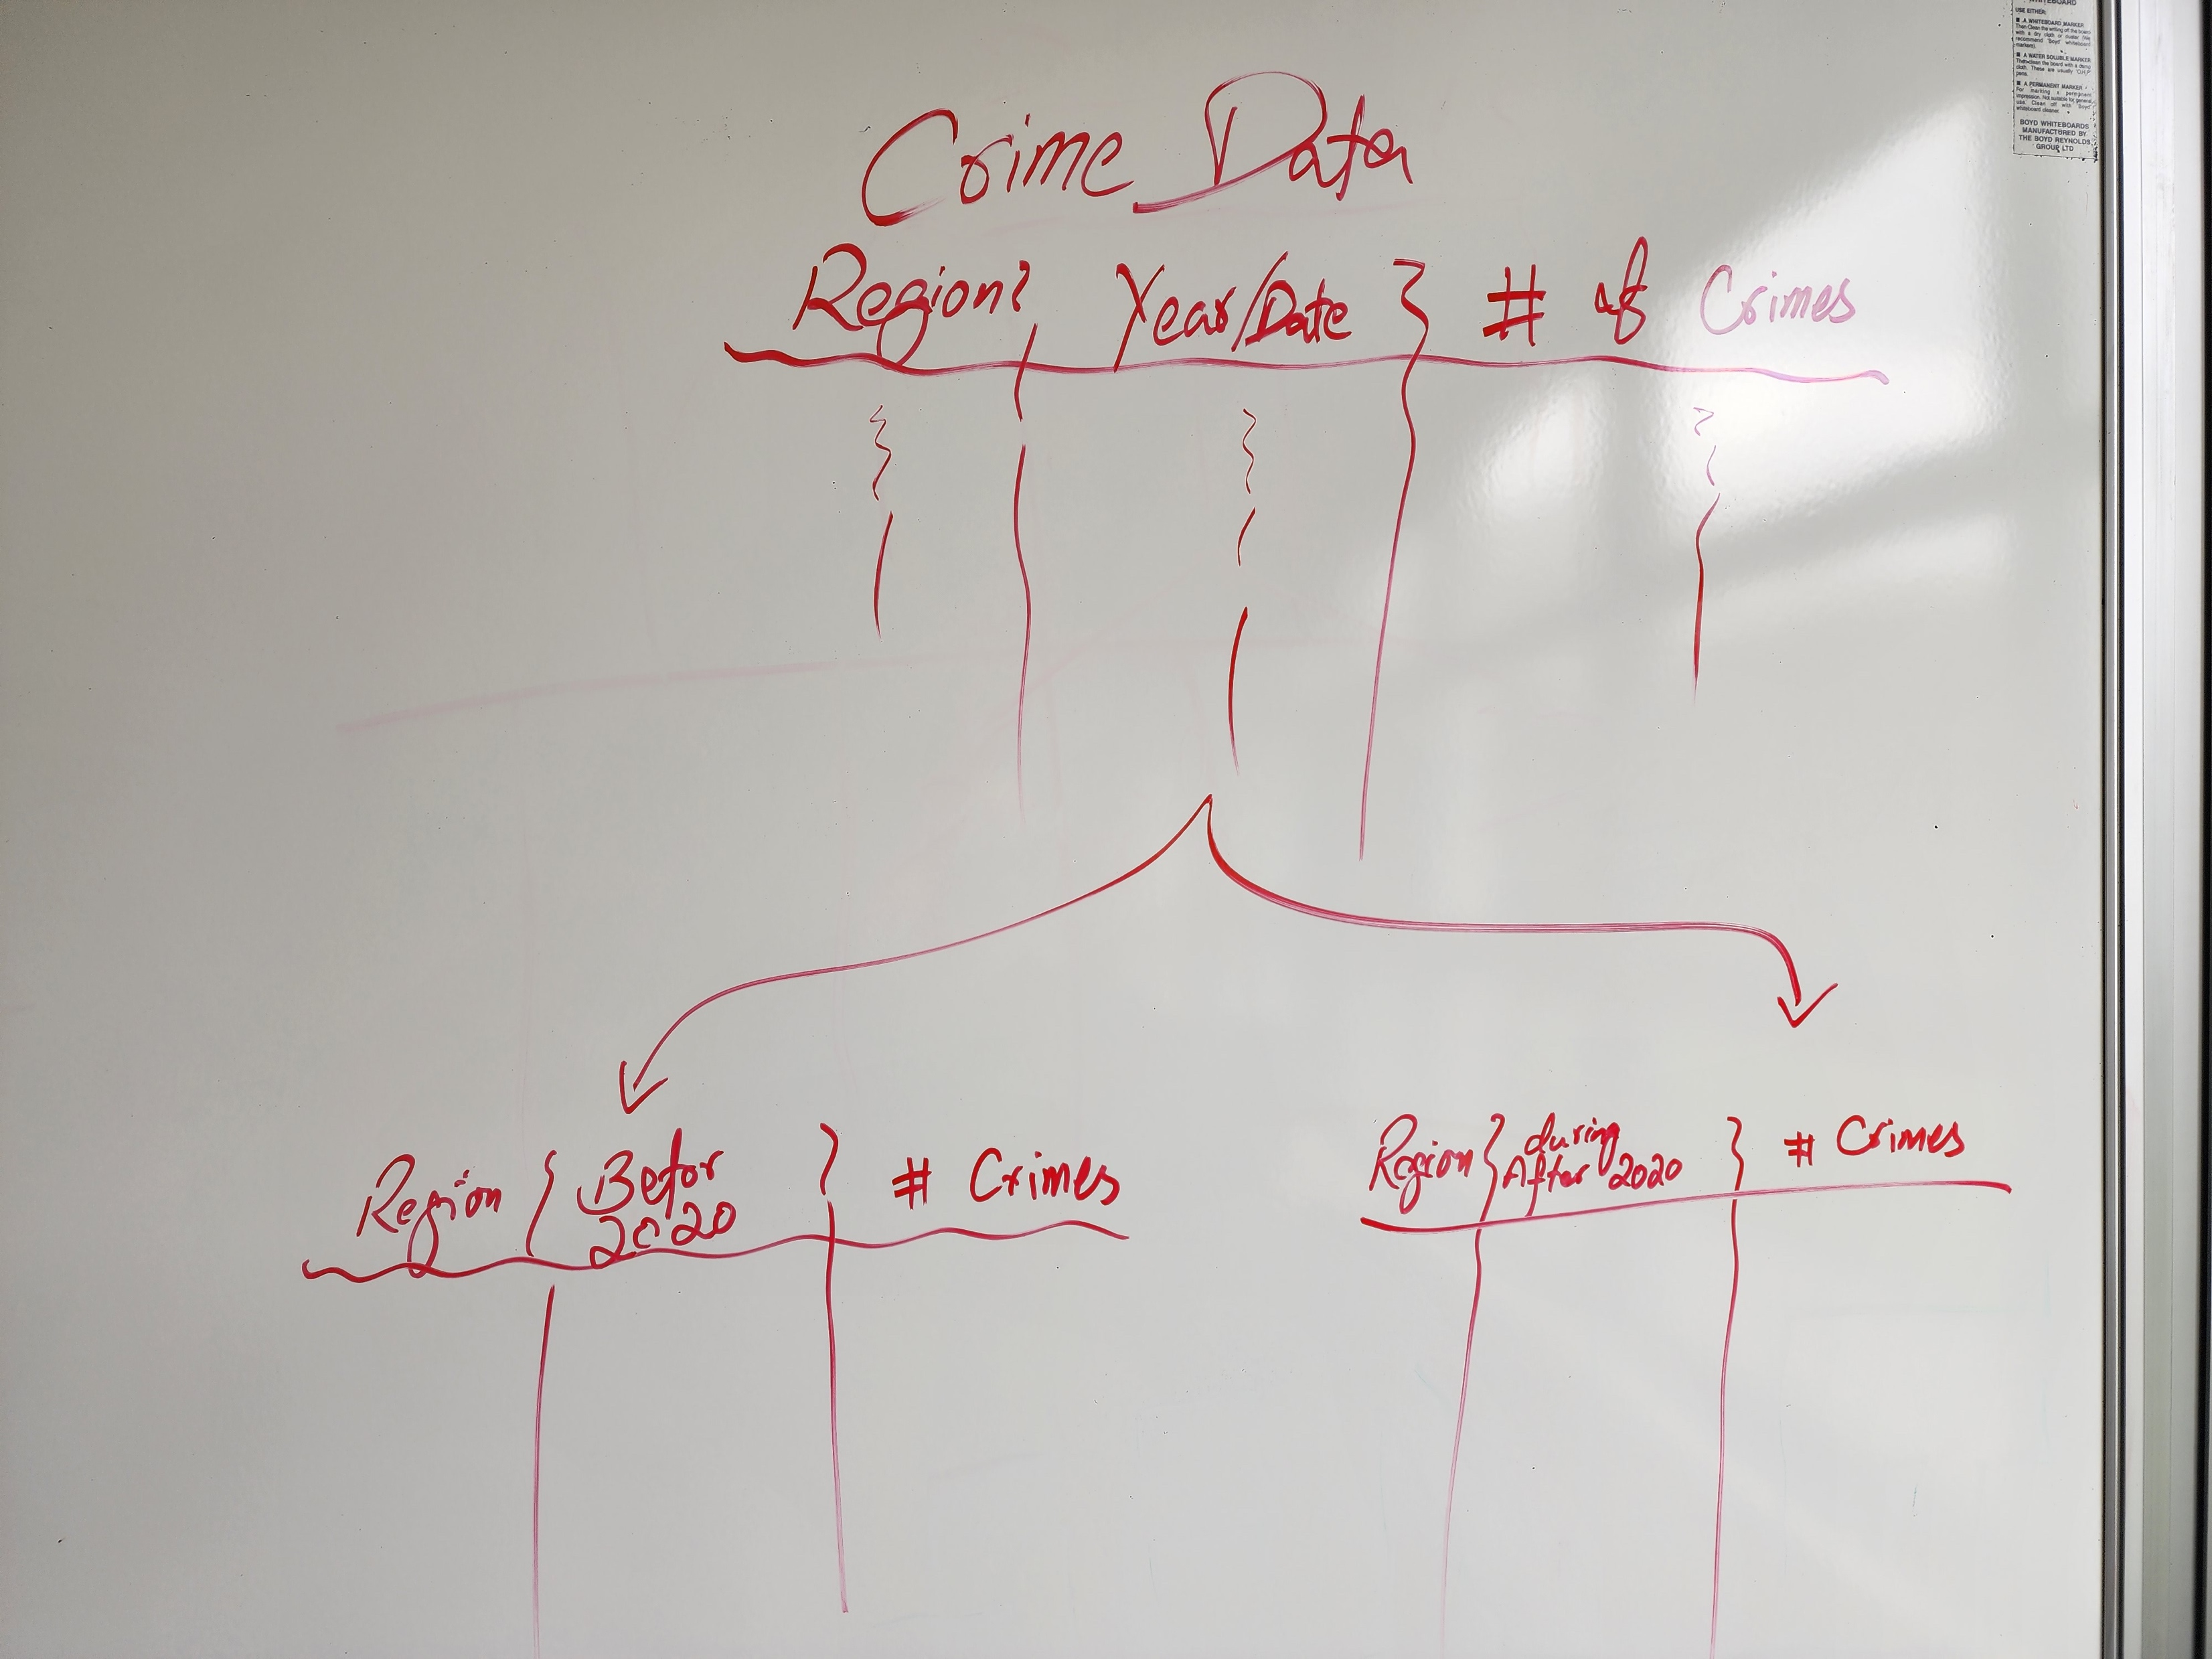
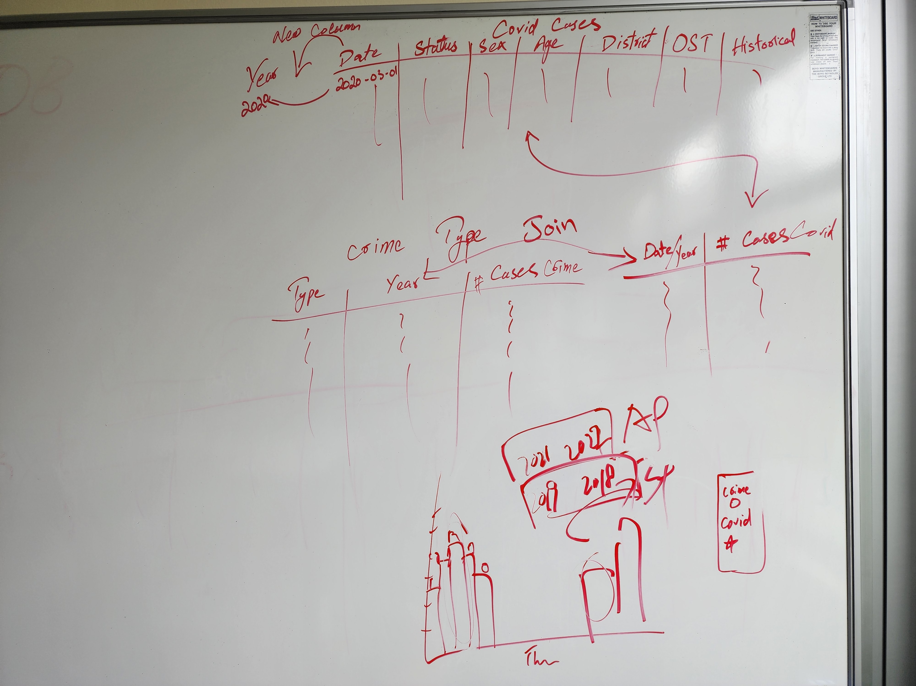
Planning
Notes:
The Major challenge we faced was to collect the correct data, there is a lot of data available on COVID but not much on how it affects different sectors, so we took data for each sector and divided into different periods, e.g., before 2020 and after.
Now we got the data but there was even bigger problem, that our data had no common ground to join the data, covid data was on daily bases, vaccination data was in date-range (weekly or so), crime data was yearly and was divided into different regions, but once again the region boundary for DHB and Police Districts.

Slide 8
Crime Rate
Add Graph
Notes:
As mentioned, earlier, the data from

Slide 9
Wellbeing
Add Graph

Slide 10
Agriculture
Add Graph

Slide 11
GDP
Add Graph

Slide 12
Conclusion
Look in the slide notes below for topics to consider talking about

Slide 13
Q&A
Add New Zealand Map Here…

Slide 14
Thank You
Honourable Mentions:
Teaching Team
Tutoring Team
Classmates

